Slide 1
適用於教育的 AWS 計劃
學生、教育工作者和研究員是技術創新的主要推動者, AWS 提供三個計劃來協助客戶將他們的研究或教學負載移至雲端，以加速創新速度並降低成本.
AWS Educate
AWS Educate 是 Amazon 的全球計劃，旨在為學生和教育人員提供所需的資源，以大幅加速與雲端相關的學習嘗試，並協助提升未來企業家、人力和研究人員的能力。
AWS Academy
為高等教育機構提供 AWS 課程，以協助學生開發所需的雲端運算技能，並做好取得業界認可 AWS 認證的準備
AWS Credits for Research
適用於研究的 AWS 雲端積分計劃支援從事下列工作的研究
建置雲端為基礎的科學型公開應用程式、軟體或工具，以推動研究工作。
執行概念驗證或基準測試，評估將研究工作或開放式資料移至雲端。
透過研討會或教學，為社群提供有關對研究工作使用雲端的培訓。

Slide 2


Teaching Tomorrow's Cloud Workforce Today
For Professors

Slide 3


So What is AWS Educate?
With the increasing demand for cloud-skilled employees, AWS Educate provides an academic gateway for the next generation of IT and cloud professionals. AWS Educate is an online platform that provides teaching material content sharing, professional development, and hands-on lab class environment. Through these features, professors will be equipped with necessary resources in teaching and developing curriculums. AWS hopes that professors can benefit from the resources AWS Educate offers and implement these materials into classrooms.

Slide 4



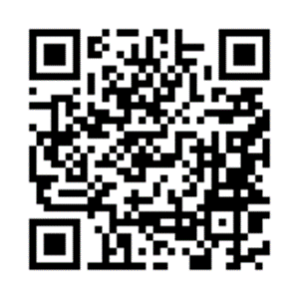
Cloud Skills Readiness with AWS Educate
For students
Starter Account (without credit card), Standard Account (with AWS Account) to receive 30-100 USD credits for AWS service renew annually
Free access to AWS Technical Essential Training Learning Course (valued at $600USD)
NEW CAREER PATHWAY - 1 Cloud Intro Class and 11 Highly Demanded Job Roles Training – Machine Learning Scientist, Big Data Scientist, Cloud Support Engineer, Web Developer, DevOps Engineer… etc.
5 Badges - gaming, startup, alexa ….
Job Board for internship and full-time opportunities – including Hong Kong jobs
For educators
NEW Starter Account (without credit card), Standard Account (with AWS Account) to 50-200 USD credits on AWS renew annually
Free access to AWS Technical Essential Training Learning Course (valued at $600USD)
1500+ Institutes Teaching Material Sharing
NEW FEATURE – AWS Educate classroom to offer hands-on lab in class with additional credits
50% off AWS certifications exams
Register NOW!

Slide 5
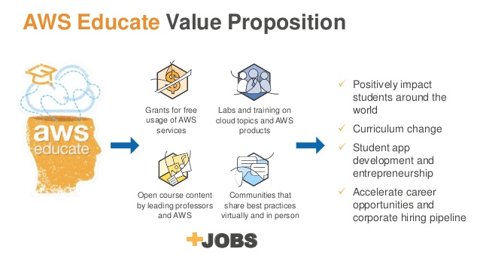

Slide 6
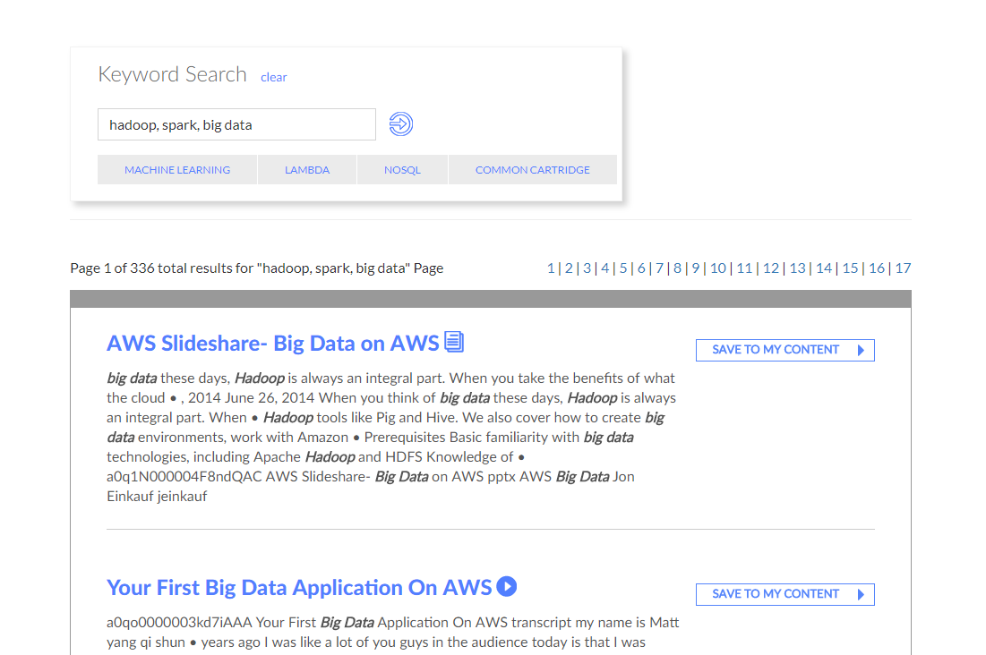
Get Content
Educator Portal allows educators to access teaching content and material from other professors from more than +1500 institutions and AWS itself
Tutorials From AWS
Slideshare From Other Professors
Homework/ Lab References
Content from Udacity and Udemy
Request Credits for Your Class

Slide 7
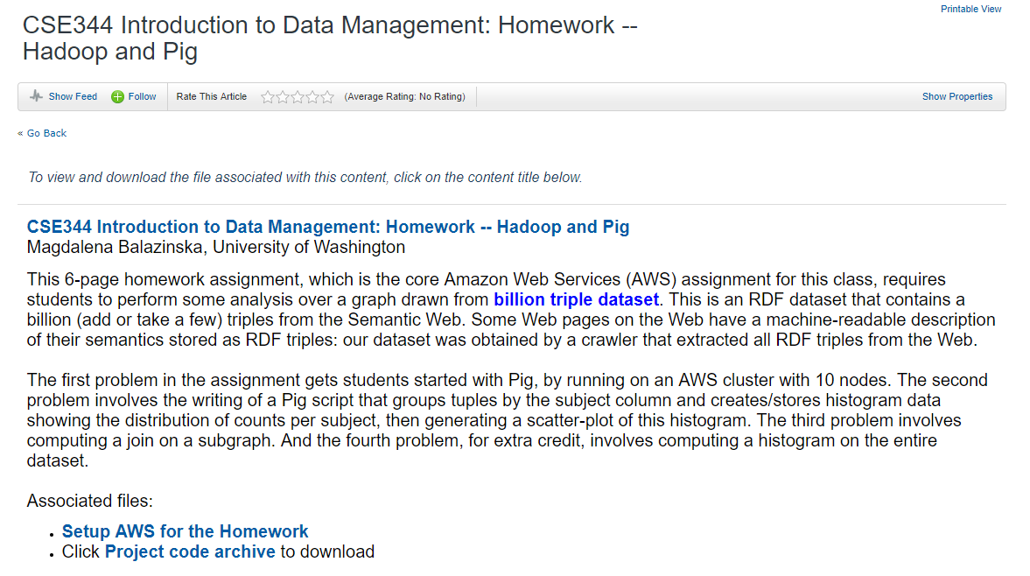

Slide 8
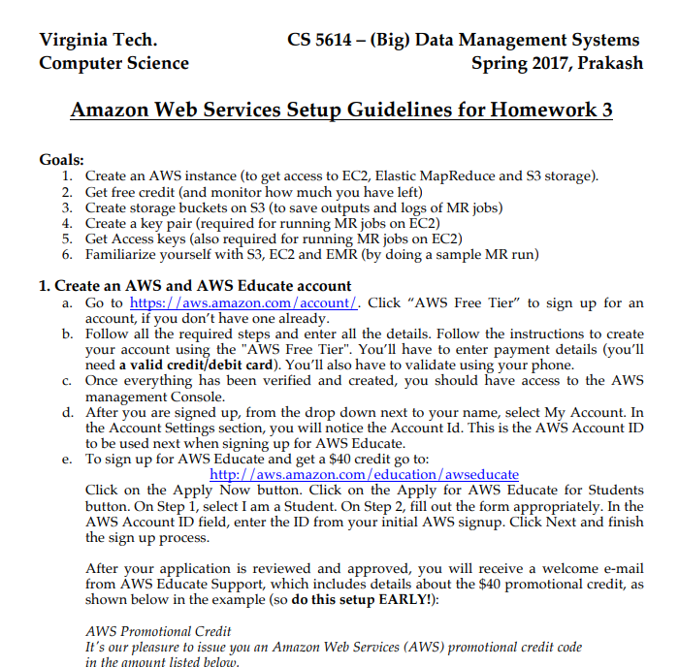
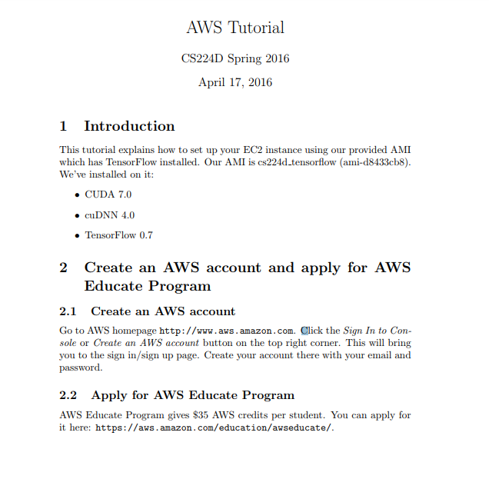
AWS Educate Example
EC2 Set Up Instructions with AWS Educate From Stanford
EC2 Sample HW From Virginia Tech
Notes:
Virginia Tech -
http://people.cs.vt.edu/badityap/classes/cs5614-Spr17/homeworks/hw3/AWS-setup.pdf
Stanford - https://cs224d.stanford.edu/supplementary/aws-tutorial-2.pdf

Slide 9
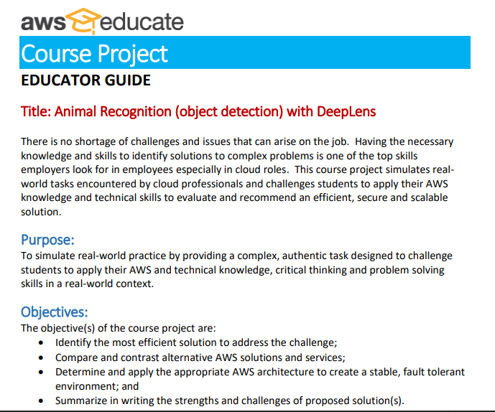
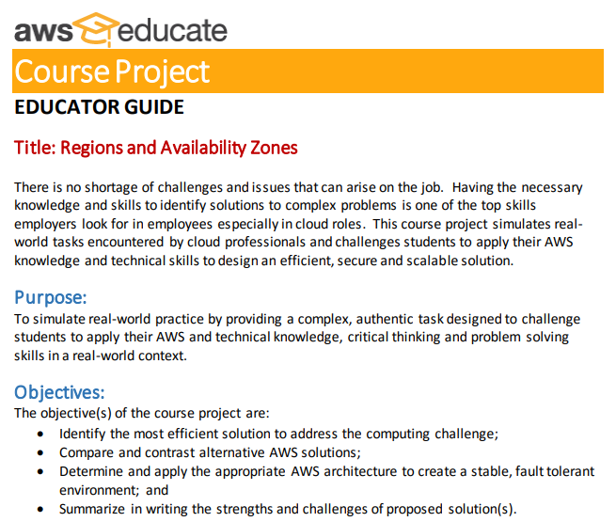
AWS Educator Guide
DEEPLENDS PROJECT
Associate Cloud Archetiect
Notes:
Login AWS Educator portal -> click on professional development -> under getting started

Slide 10
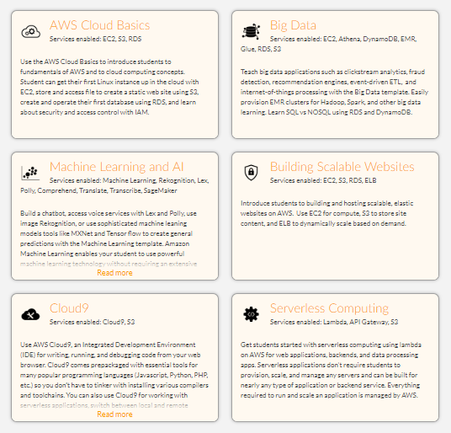
Classroom
AWS Educate Classroom is an educational cloud lab environment provided by Vocareum. Through AWS Educate classroom, Educators can experience secured lab environment with 50 more promotional credits by default.
This classroom offers teacher ability to get a full picture of every students credits usage and services used (Activity or Resource Report) or accessing individual students work area (AWS Console)
Notes:
https://s3.amazonaws.com/awseducate-classrooms-overview/AWS+Educate+Educator+Classrooms+Overview.mp4

Slide 11
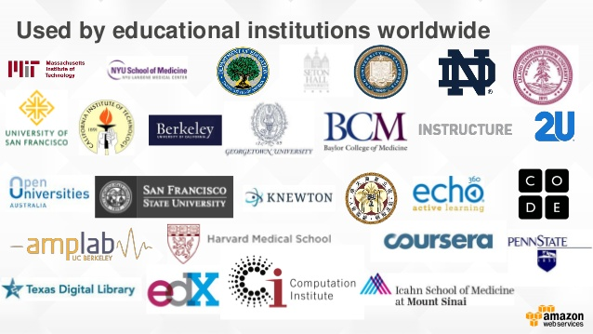
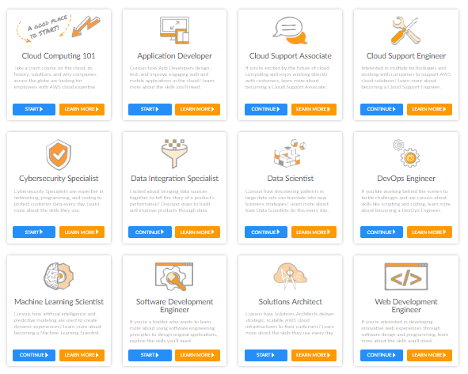
Cloud Career Pathway
Cloud Career Pathway is a self-pace learning environment that provides 1 cloud intro class with 11 different most demanded job role for students to gain necessary skills and knowledge. Every pathway includes videos, text, quizzes, practice labs, and final project. After completing each pathway, students can gain AWS Educate certification and digital badge.
For students from the age of 14-17, they will be able to access 1 cloud intro class (Cloud Computing 101) to start learning and understand more about cloud!
Every students with no age restriction will have the opportunity to practice AWS in the lab environment!

Slide 12
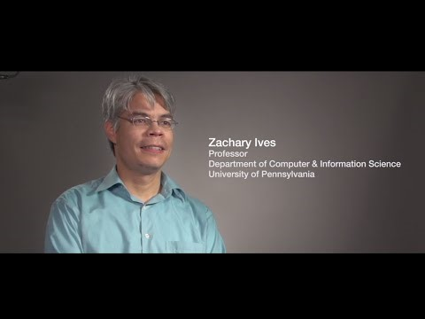
U. Pennsylvania Students Access Cloud Resources with Help from AWS Educate
D

Slide 13
Teaching Tomorrow's Cloud Workforce Today
For Students

Slide 14
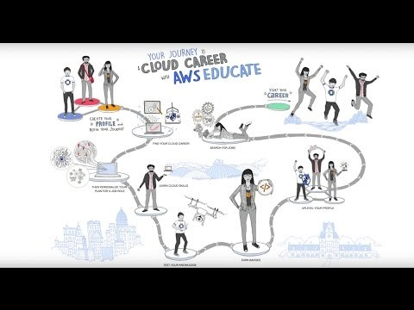
Let’s Watch a Video First!

Slide 15
Cloud Career Pathway
Cloud Career Pathway is a self-pace learning environment that provides 1 cloud intro class with 11 different most demanded job role for students to gain necessary skills and knowledge. Every pathway includes videos, text, quizzes, practice labs, and final project. After completing each pathway, students can gain AWS Educate certification and digital badge.
For students from the age of 14-17, they will be able to access 1 cloud intro class (Cloud Computing 101) to start learning and understand more about cloud!
Every students with no age restriction will have the opportunity to practice AWS in the lab environment!

Slide 16
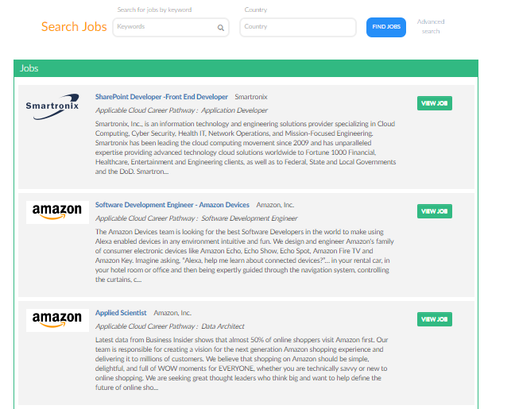
Job Board
Every students over the age of 17 will be able to access job board. Students will be able to see what pathway is associated what kind job roles in order to understand the skills needed with particular jobs.
Students will be able to upload resume and attach the digital badges or AWS Educate certifications after completing a pathway to show to the recruiter!

Slide 17






Example of utilizing the AWS credits grants
Amazon IoT Platform – Using Utility sensor data and Machine learning to predict spikes in usage and customer behavior and more…
IoT MQTT protocol
IoT action
Amazon DynamoDB
Amazon Machine Learning
AWS IoT
IoT thing utility
IoT Action
AWS IoT - $5 for 1 million messages
DynamoDB – 25GB free
Amazon Machine Learning - $0.42 per hour

Slide 18
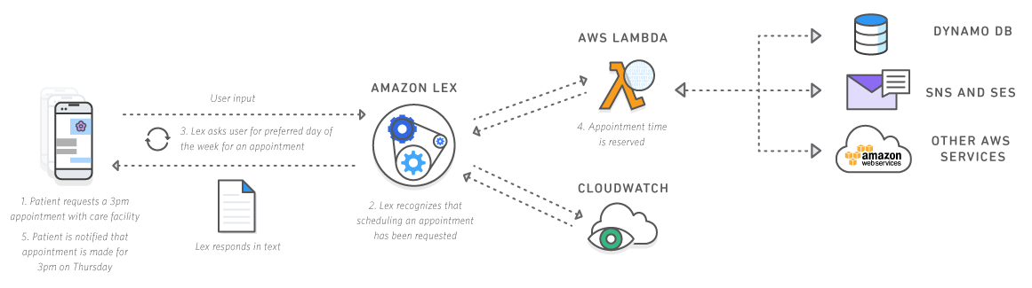
Example of utilizing the AWS credits grants
AWS Chatbot
Amazon Lex - $0.004 per voice request
AWS Lambda – 3’200’000 free seconds per month
AWS Cloudwatch – Free
AWS Simple Notification Service (SNS) - $0.50 per million notifications

Slide 19

What's AWS Educate Program All About? Hear It from Students & Educators
D

